Slide 1
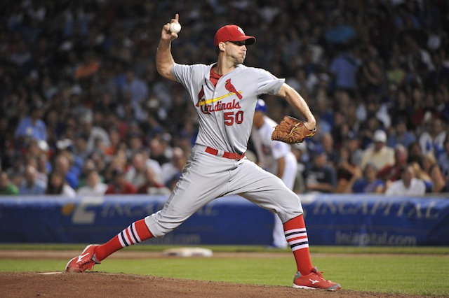

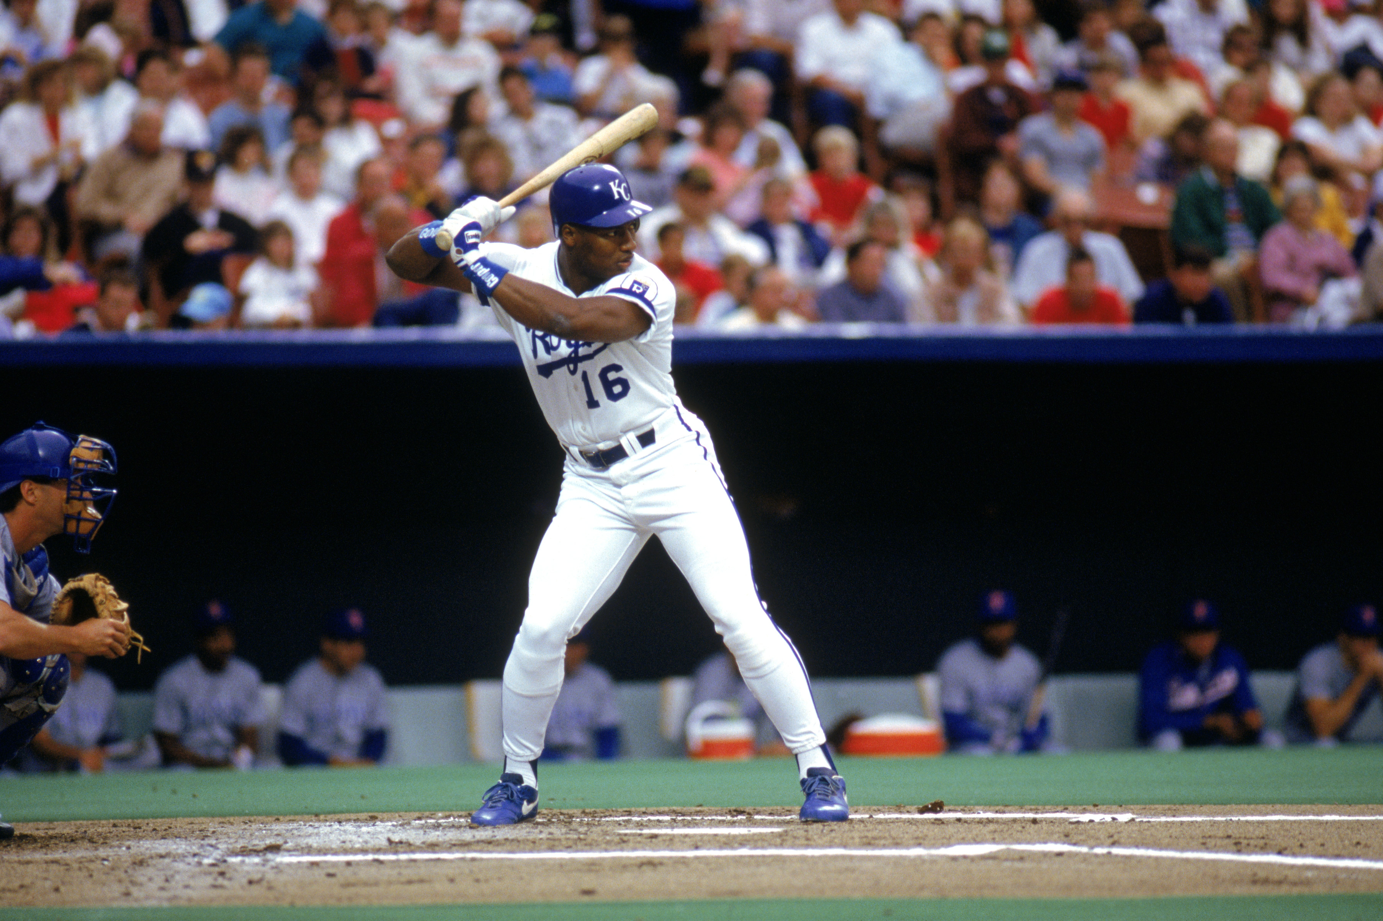
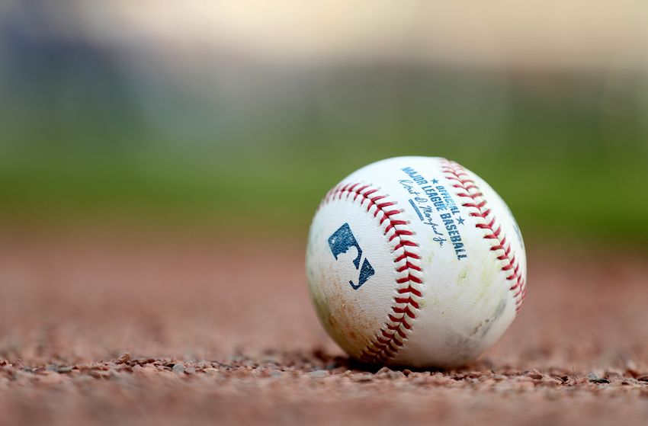
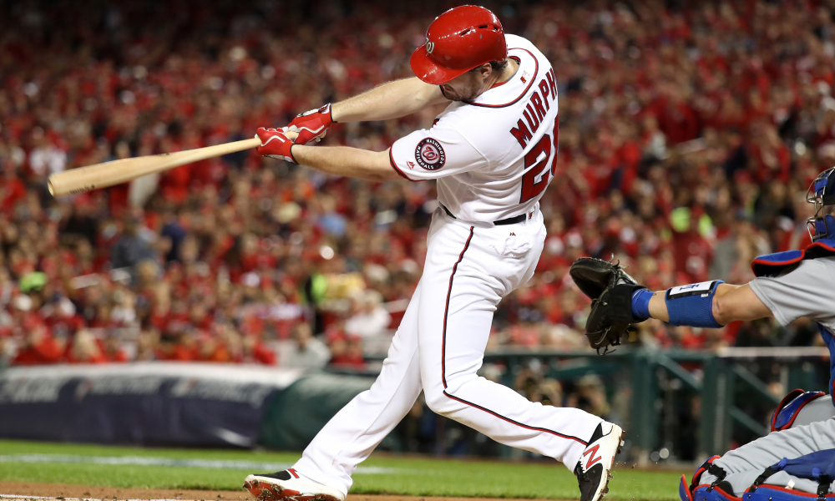

Slide 2
Project 1: MLB Pitch data 2015-2018, 2.8M pitches
Team Members:
Tim Netherton, Kale Ford
Andrew Skinner, Karishma Borse

Slide 3
Keep in mind
Pitch Count:
The pitcher wants to keep the pitch count low because of his stamina. Often a starting pitcher will be removed from the game after 100 pitches, regardless of the actual number of innings pitched, as it is reckoned to be the maximum optimal pitchcount for a starting pitcher.
General Baseball Rules:
There are 9 innings in a game. The team with the most Runs at the end of the game wins. Most starting pitchers pitch 3-5 innings.

Slide 4
Problems we are testing
Is the left-handed batter more effective than the right-handed batter?
Why are there so many types of pitches?
What pitch is most effective for producing strikes?
What is the likelihood of each pitch thrown producing a ball, strike, or foul ball?
When a hit is made, what is the likelihood that you receive a home-run, single, double, or triple?

Slide 5
Is the left-handed batter more effective than the right-handed batter?
Even though right-handed batters produced more home-runs than left-handed batters. The effectiveness of left-handed batters should not go unnoticed.
Only 10% of the population is left-handed, which leads us to believe that it is an advantage to be left-handed in Major League Baseball.

Slide 6
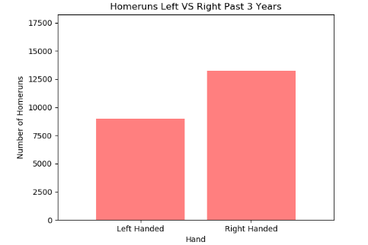

Slide 7
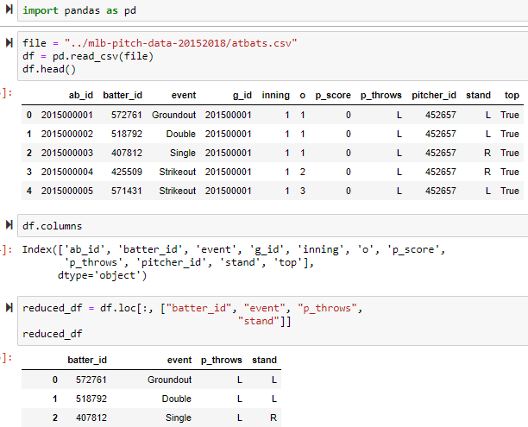
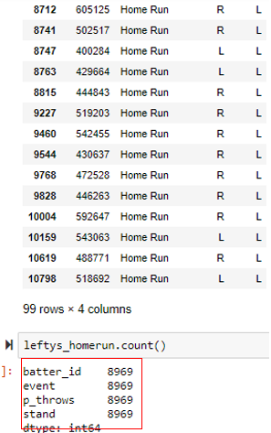
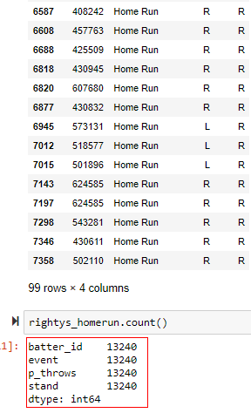
How this data was produced

Slide 8
What pitch is most effective for producing strikes and foul ball?
From the data we collected we found that the slider was the most effective pitch when trying to produce a strike.
We also found that the 4-Seam Fastball produced the highest likelihood of a foul ball.

Slide 9
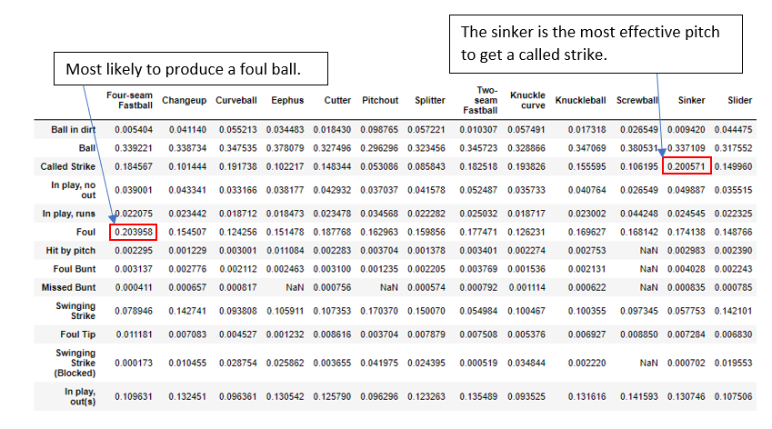

Slide 10
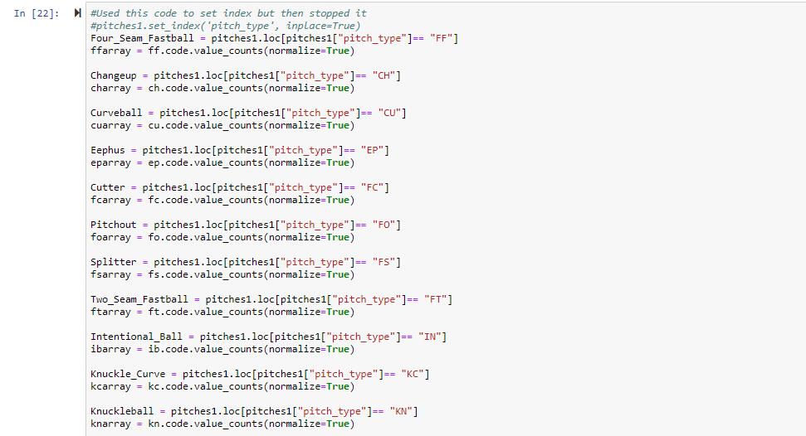
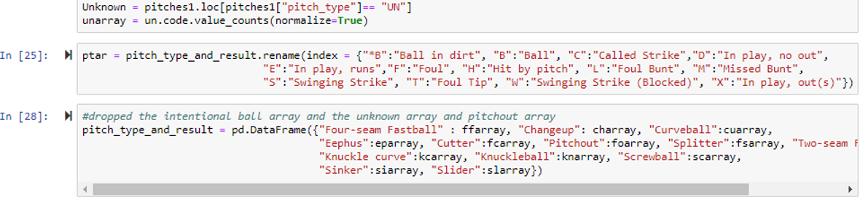
How this data was produced

Slide 11
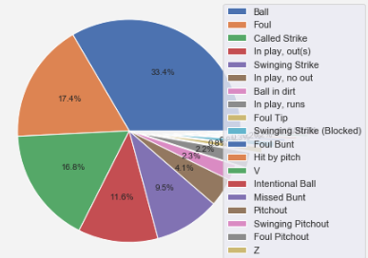
MOST COMMON PITCH OUTCOMES: ALL PITCHES

Slide 12
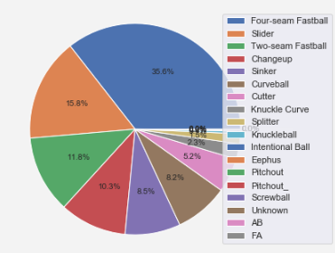
Most common MLB pitches: All Pitches

Slide 13
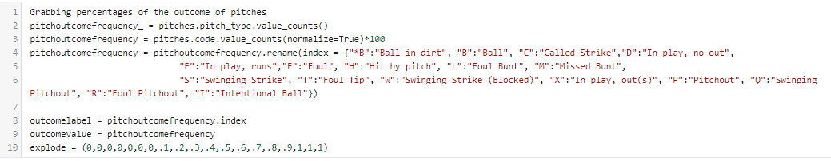
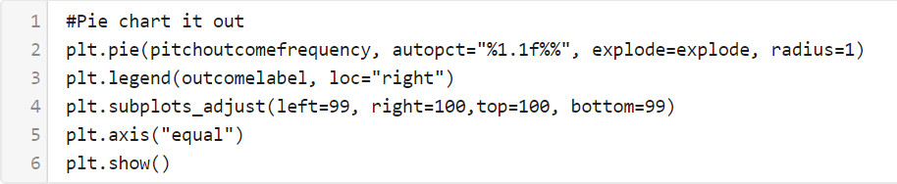
How this data was produced

Slide 14
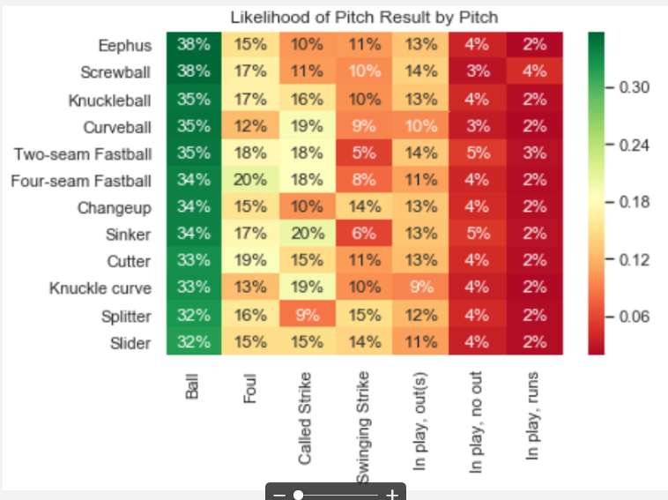

Slide 15
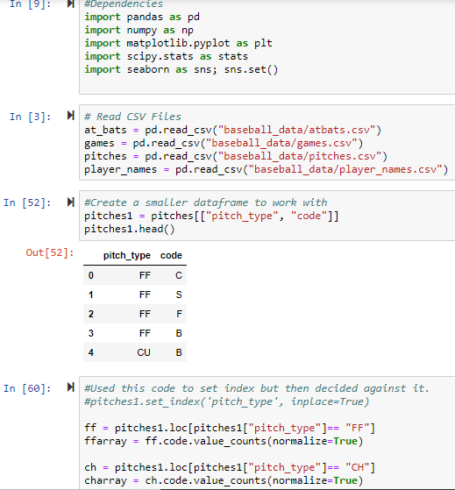
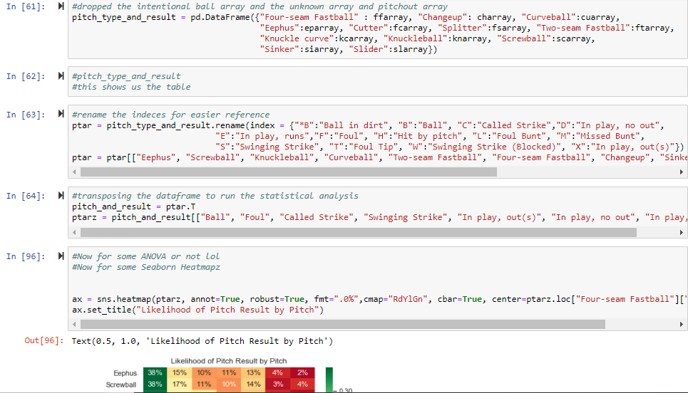
How this data was produced

Slide 16
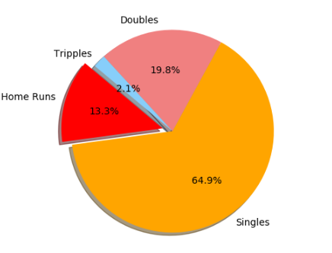
PROBABILITY OF WHAT WILL HAPPEN AFTER A “HIT” IS MADE

Slide 17
conclusions
Is the left-handed batter more effective than the right-handed batter?
From our data we found that right handed batters produced more home runs, yes. But given the fact that 10% of the world’s population is left-handed, it is amazing the amount of home runs that were hit by left-handed batters. Simply being left-handed doesn’t make you a good baseball player, the same way that being tall doesn’t make a great basketball player. However there is a correlation to how left handers are found to be more effective batters.
Why are there so many types of pitches?
Each pitch is different and each pitch presents it’s own challenges. It is vital for any pitcher to be unpredictable. There were 12 pitches that we had tested. We want to know if certain pitches were found to be more effective than others.
What pitch is most effective for producing strikes?
The sinker.
Likelihood of the pitch thrown producing a ball, strike, or foul ball?
This information was found from our heatmap.
When a hit is made, what is the likelihood that you receive a home-run, single, double, or triple?
This information was found from our last pie chart. 64.9% of the time being a single.

Slide 18
Thank you! Questions?

